Slide 1
Designing for Accessibility, Low Literacy, and Low Connectivity
Kalah Kennebrew
Dissertation presentation for the MSc Dissertation Module
School of Computing Sciences, University of East Anglia, 2025/26
Research Question: How can optimizing for accessibility, low-literacy, and low-connectivity in e-government interfaces improve task completion on the Zavala County, Texas website?

Slide 2
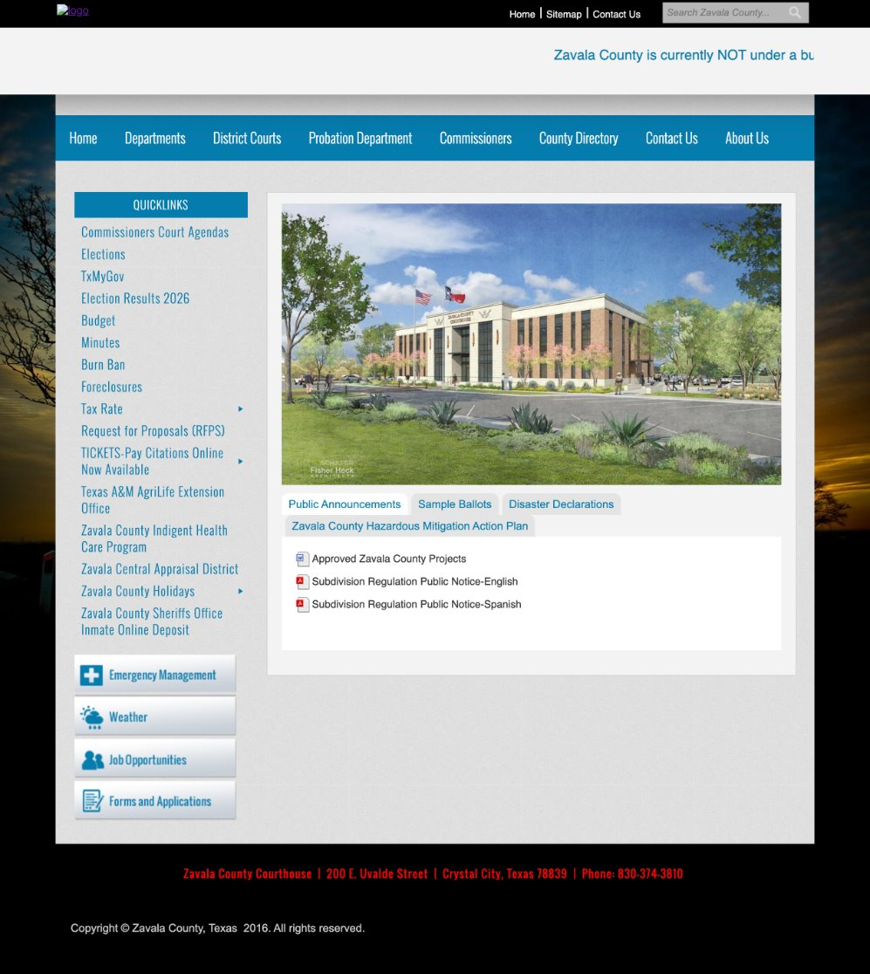
Zavala County
Located in Southwest Texas​
Sits at the U.S.- Mexico border
​
Its main town, or county seat, is Crystal City​
92.7% of residents identified as Hispanic or Latinx (U.S. Census Bureau, 2025)​
83.3% households have broadband access; 1 in 6 households without broadband (U.S. Census Bureau, 2025)​
About Zavala County
Zavala County Website co.zavala.tx.us

Slide 3
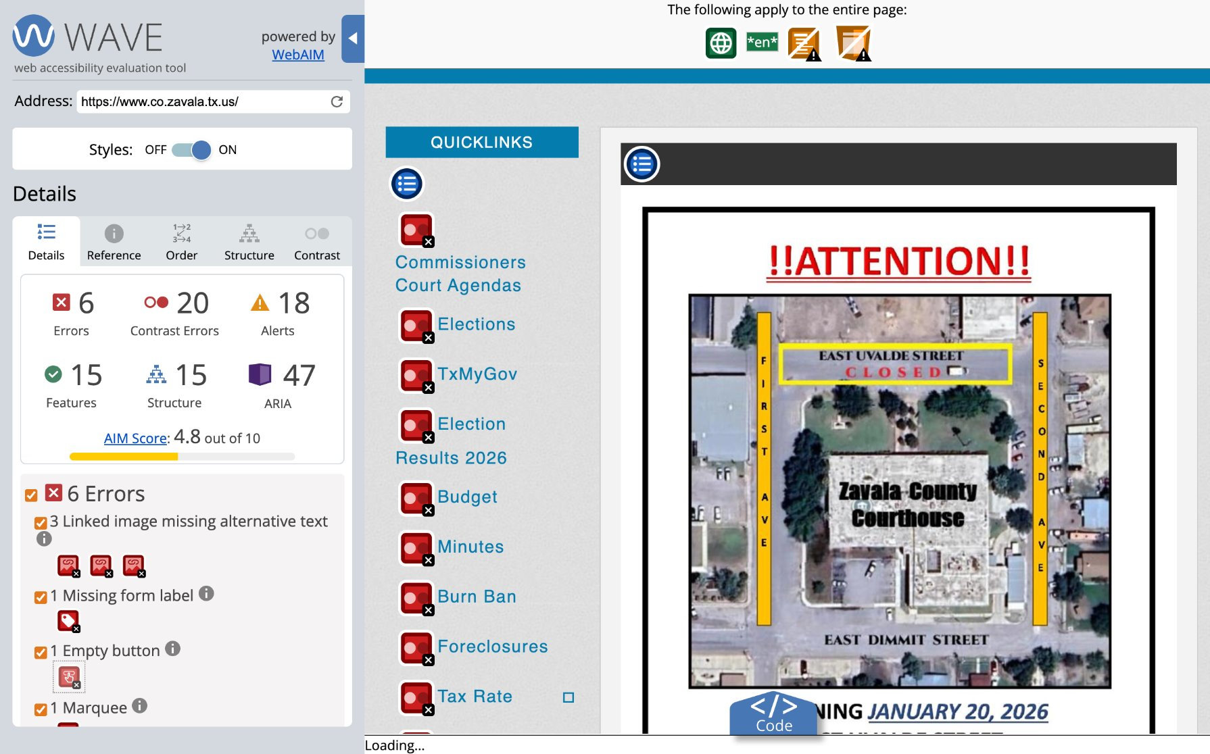
The problem
1
No working search users must guess which category holds a service
2
Dense, unclear navigation key information sits multiple clicks deep
3
No plain-language content dense, bureaucratic phrasing throughout
4
No Spanish-language pages excludes the 92.7% of residents who identify as Hispanic or Latino

Slide 4
Demo
Live walkthrough of the redesigned prototype

Slide 5
Design rationale
1
Simplified navigation reduced to four core links, so key services are never more than one click away
2
Real-time search client-side search returns results instantly as the user types
3
Plain-language content site copy rewritten for a lower reading level throughout
4
Spanish-language option full parallel-language pages, not a browser-translation toggle
5
No AI-driven features chatbots and voice navigation excluded, since the evidence for their accessibility benefit is largely unevaluated in the current literature (growing body of research)

Slide 6
Methodology
Mixed-methods evaluation: interviews, observation, and timed tasks
5
Each participant tested both the original site and the redesigned prototype
Task-based scenarios mapped directly to specific recommended design decisions
participants
moderated usability study
Pre-task and debrief questions captured perception alongside behavior

Slide 7
Results
31 original / 35 redesigned task attempts, 5 participants, 9 administered tasks
Metric | Original | Redesign | Change
Task success rate | 80.6% | 97.1% | +16.5 pts
Hesitation rate | 71% | 46% | -25 pts
Rated “easy” | 51.6% | 97.1% | +45.5 pts
Would give up | 9.7% | 2.9% | -6.8 pts
Mean completion time | 50.61s | 25.25s | -50%
Task 10 (accessibility toolbar) exists only on the redesign, so it adds attempts with no original-site counterpart. Task 5 (Spanish-language) was skipped in every session, since none of the five participants read Spanish, so the Spanish pages were never evaluated through a task.

Slide 8
Where the redesign fell short
Task 1: Nutrition Center contact
Task 2: County clerk information
Hardest task on both versions: 3 of 5 “no” results were on this task, original site
Completion time regression: 41.06s → 63.37s, 54% slower on the redesign
The redesign’s only outright failure (Participant 5)
Negative for 3 of 4 participants tested on both versions, a repeated pattern rather than one outlier
The redesign’s only remaining give-up instance (Participant 5)
Cause: participants expected clerk info under Topics & Services or the County Directory, and had to detour through About Us instead
Cause: P5 got lost on an external site (Texas AgriLife) the task links out to, not the prototype itself
The underlying search worked fine. This is an information architecture problem, not a content or search problem

Slide 9
Limitations and future work
Limitations
Future work
Single case study, not a large-scale evaluation
A larger and more diverse sample
Small sample size (n = 5)
Slow or degraded connection evaluation
Short-term evaluation window
Task protocol not vetted by “field experts”

Slide 10
Thank you

